Slide 1
A research on the relationship between Age and the incident rate of the Parkinson’s disease
吴羽书 霍昊 周云笛

Slide 2
目录
CONTENTS
01
02
03
INTRODUCTION, PROBLEM, PURPOSE
RESEARCH
METHODS AND PROCEDURES
04
05
06
RESULTS (ANALYSIS OF DATA)
PROBLEMS IN THE PROJECT/SUGGESTIONS FOR FUTURE
CONCLUSION

Slide 3
INTRODUCTION, PROBLEM, PURPOSE
1
单击此处添加文本具体内容

Slide 4
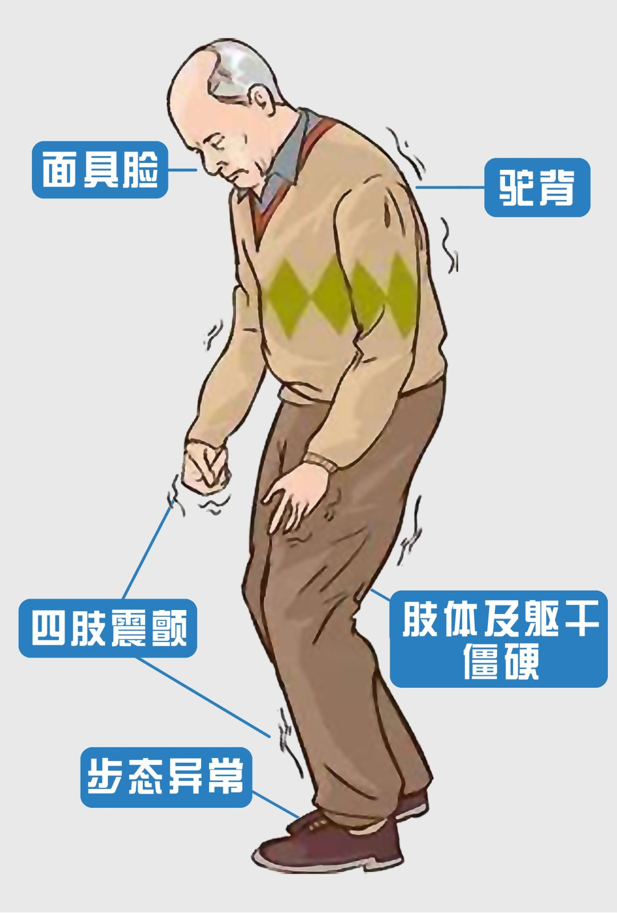
Introduction
Parkinson’s disease, discovered by British doctor James Parkinson, is a neurodegenerative disease that might cause Quiescence tremor, bradykinesia, myotonia, and postural gait disorders. Parkinson disease is caused by degeneration and death of dopamine neurons in the midbrain substantia nigra, and the cause of such pathological change is still unknown. Many factors might contributed to the incident of Parkinson’s disease include genetic factors, environmental factors, aging and oxidative stress. Our study today will primarily focus on the effect of aging on the incident rate of Parkinson’s disease.

Slide 5
RESEARCH
2
单击此处添加文本具体内容

Slide 6
Research
With the profound research to Parkinson Diseases, we found some basic factors that may affect the results of the relation of ages and the incidence of the Parkinson.Based on the fundamental research from the WHO, reported that “In addition, men are 1.5 times more likely to develop Parkinson's disease than women”. Sex, are the main confounding variables which can disturb this observational study and alter the conclusion, which should must be considered as an important factor.

Slide 7
METHODS AND PROCEDURES
3
单击此处添加文本具体内容

Slide 8
Data Collected
01
Sampling Method
03
Data Extraction
05
Ethical Considerations
The researchers utilized a random sampling method to select the clinical history of patients with Parkinson's disease.
Dino's father, a neurological doctor and collaborator on the project, played a crucial role in the data extraction process.
Throughout the data collection process, ethical considerations were followed. Patient confidentiality and privacy were strictly maintained.
02
Informed Consent
04
Data Validity and Reliability
Prior to data collection, the researchers obtained informed consent from the patients or their legal guardians.
To ensure the validity and reliability of the data, Dino's father, being an experienced neurological doctor, verified the accuracy of the extracted information.

Slide 9
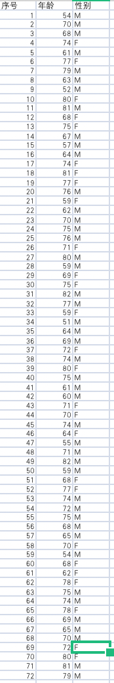

Slide 10
RESULTS (ANALYSIS OF DATA)
4
单击此处添加文本具体内容

Slide 11
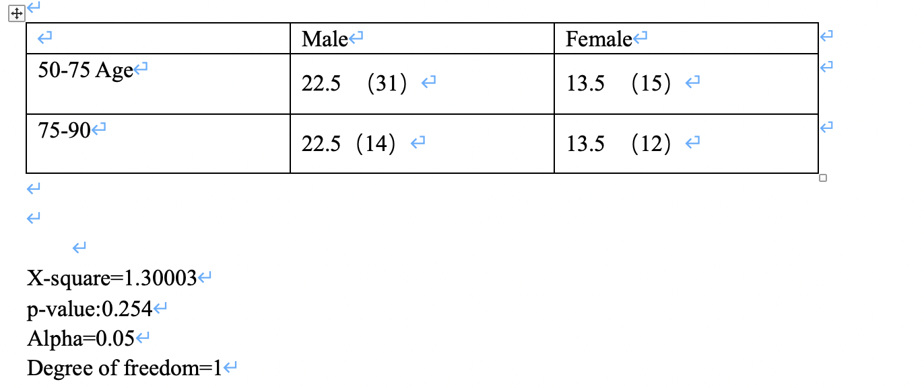

Results
Null hypothesis: The age has no relationship with the incidence of the Parkinson diseases.
Alternate Hypothesis: The age has relationship with the incidence of the Parkinson Disease.

Slide 12
PROBLEMS IN THE PROJECT/SUGGESTIONS FOR FUTURE
5
单击此处添加文本具体内容

Slide 13
Problems
1
2
3
the availability of comprehensive and accurate clinical histories of Parkinson's disease patients.
The provided dataset lacked information on the diagnostic criteria used to confirm Parkinson's disease cases.
the dataset had an unequal distribution of genders, with a higher representation of males.
Problems
A

Slide 14
Reccomendation
Recommendation
1
2
3
4
it would be beneficial to expand the study's scope beyond a single hospital or region to include multiple healthcare facilities across China.
future research should incorporate more comprehensive data collection, including genetic factors and potential environmental influences.
longitudinal studies would provide valuable insights into the temporal relationship between age and Parkinson's disease incidence.
it would be beneficial to employ a matched control group without Parkinson's disease.

Slide 15
CONCLUSION
6
单击此处添加文本具体内容

Slide 16
Conclusion
In our experiment, we don’t come up to an association between the age and the incident rate of the Parkinson’s disease due to confounding variable like gender. However, Most cases of PD occur over the age of 60, suggesting that aging is related to the disease. Some of the research suggest that dopaminergic neurons in the substantia nigra gradually decrease with age in normal adults, which might be the cause of the association of ageing and the incident rate.

Slide 17
References
[1] Quinn, N. P., and F. A. Husain. “Parkinson’s Disease.” British Medical Journal (Clinical Research Edition),
vol. 293, no. 6543, 1986, pp. 379–82. JSTOR, http://www.jstor.org/stable/29524136. Accessed 18 May 2023.
[2] The second most common neurodegenerative disease: Parkinson’s disease - acrobiosystems,Where Proteins and Innovation Advance Biomedicine.https://www.acrobiosystems.com/A1560-The-second-most-common neurodegenerative-disease(Web.)May 26. 2023

Slide 18

Thanks
勇敢·收获·成长

